Slide 1
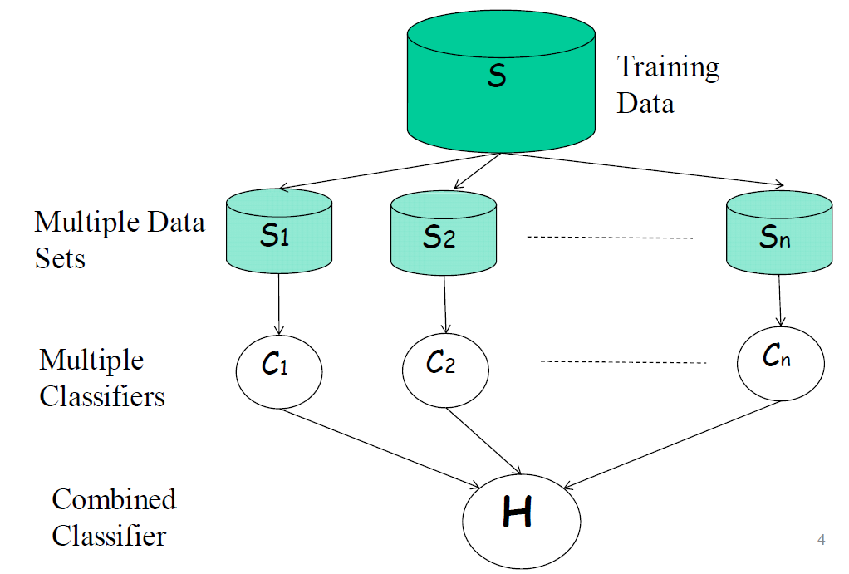

Ensemble of Classifiers
Performance can be improved using a "pool" of classifiers.
How should we build and combine different classifiers ?

Slide 2
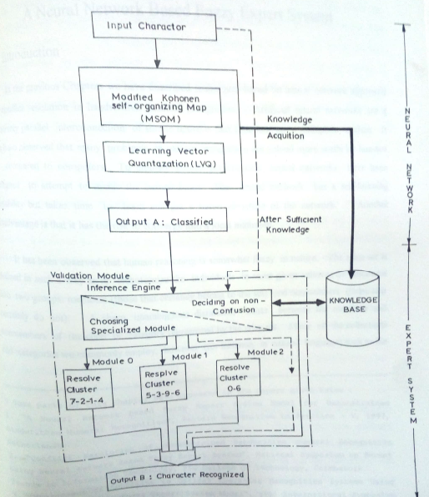
Hybrid Architectre

Slide 3
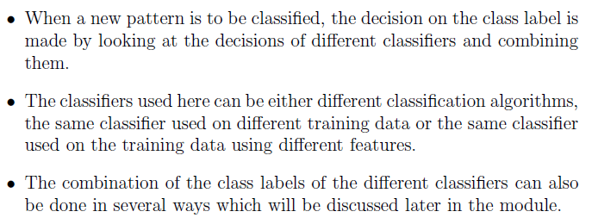
Combination of Classifiers

Slide 4
Methods of Constructing Ensemble of Classifiers
1. Subsampling the training set
2. Varying features used in the training set
3. Varying the classes by combining the classes and partitioning into two or more blocks.
4. Varying the classifier by using randomness
5. Some methods specific to certain type of classifiers.

Slide 5
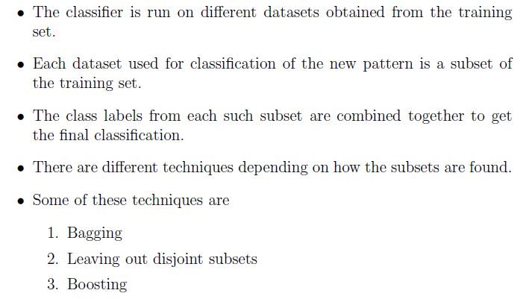
Subsampling the Training Set

